Slide 2
Outline
About us
Our team / Seat layout
General instruction
Activities
Our technology
Contact us

Slide 3
About us
We are the Offshore software companies that specializes in providing state-of-the-art software outsourcing solutions and services for Global Market.
Year of establishment: 2005
Number of employees: 70+
Clients: We focus on Global market.
At present we have clients in US, Switzerland, Norway, Germany, England, Ireland, Canada, Australia and Japan.

Slide 4
Management
Managing Director:
Ms. Nhung Nguyen
CTO:
Mr. Oyvind Forsbak

Slide 5
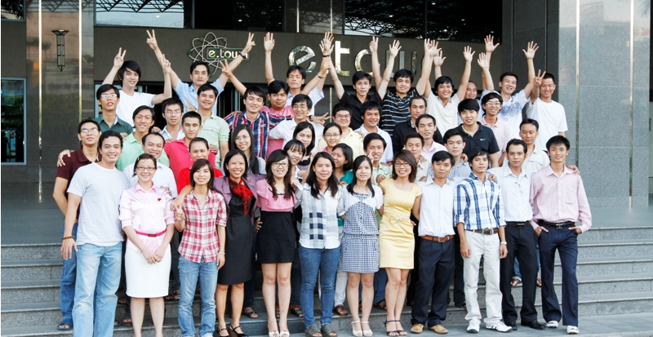
OUR TEAM
Our talented and highly motivated team of programmers and developers who have been well selected to complement the level of customer’s skill set and culture

Slide 6
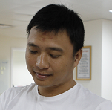
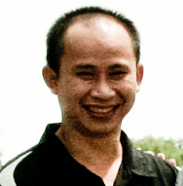
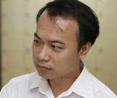
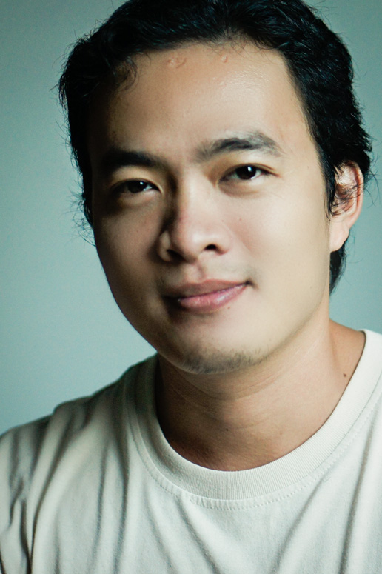


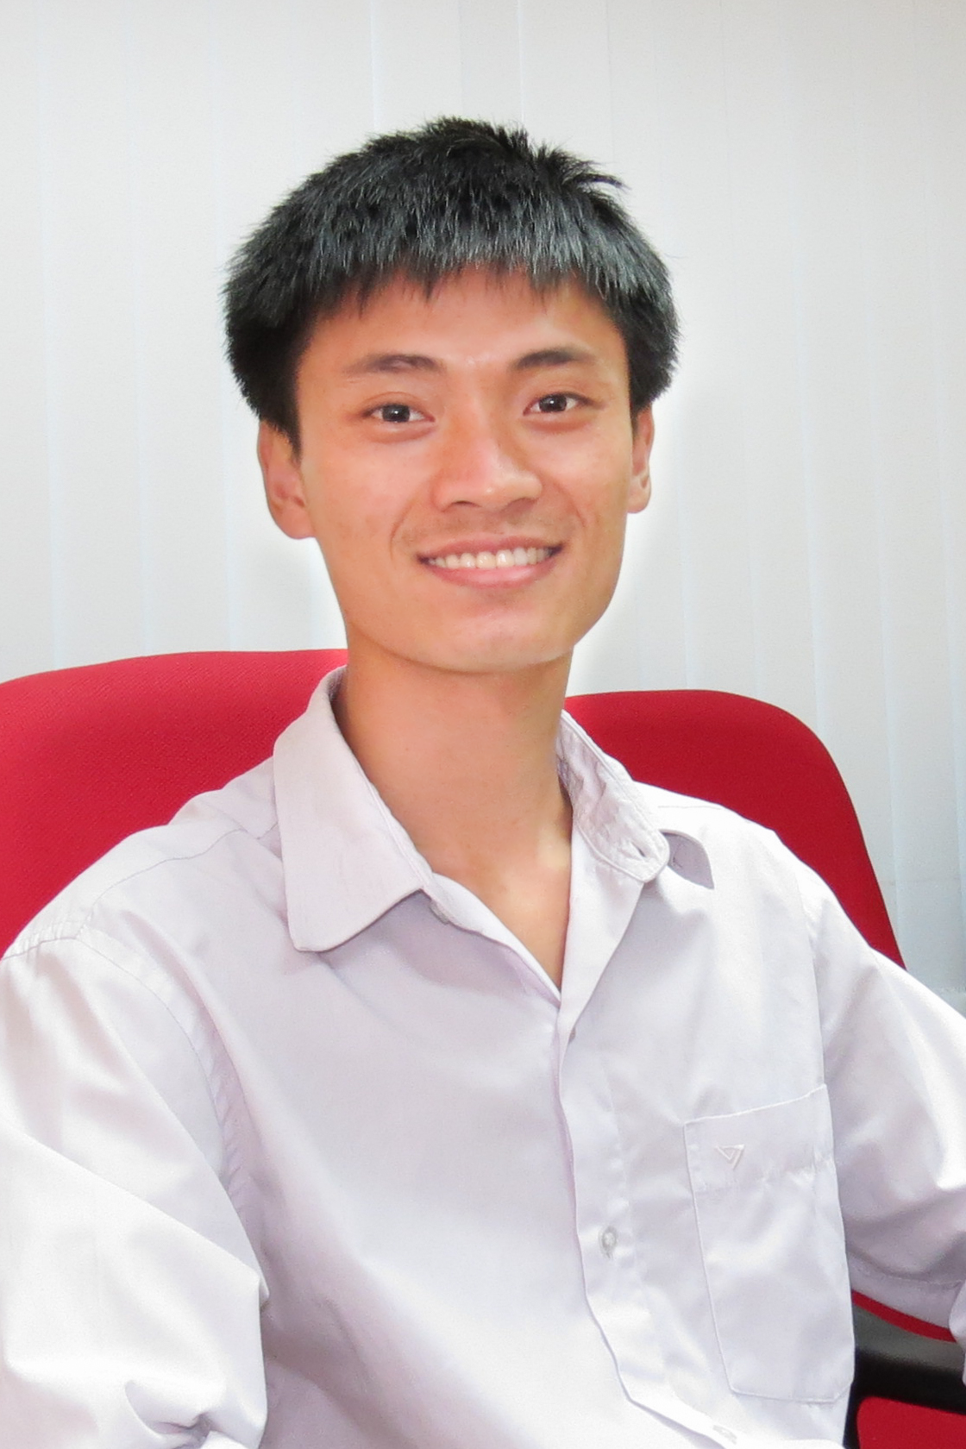
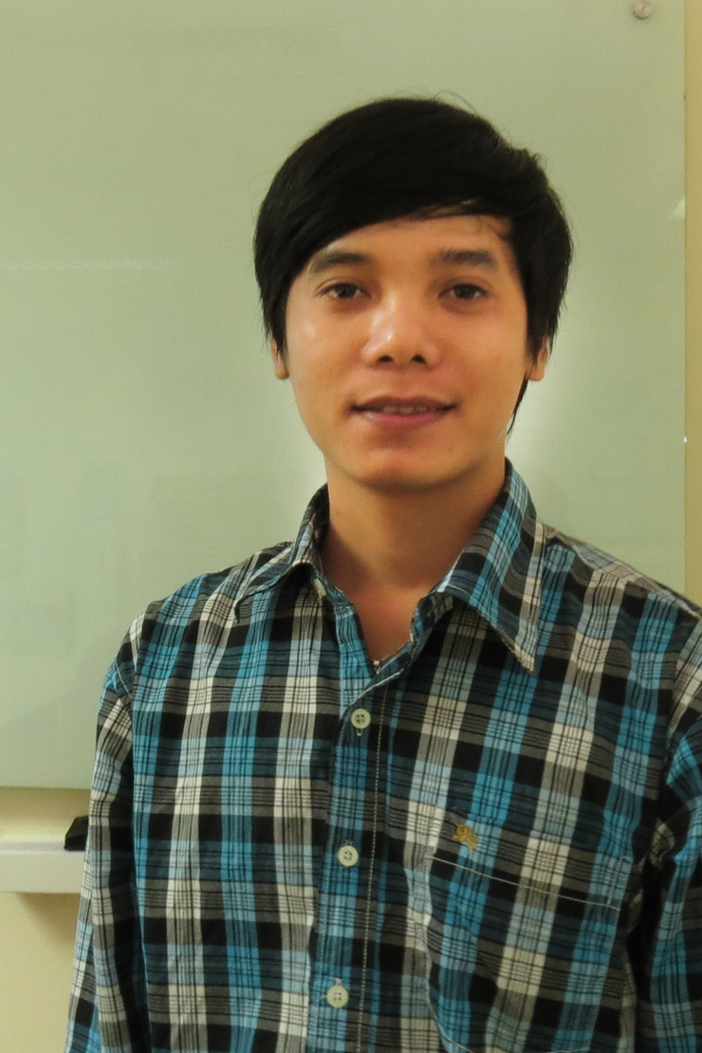
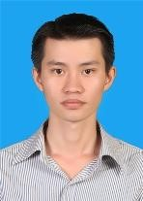
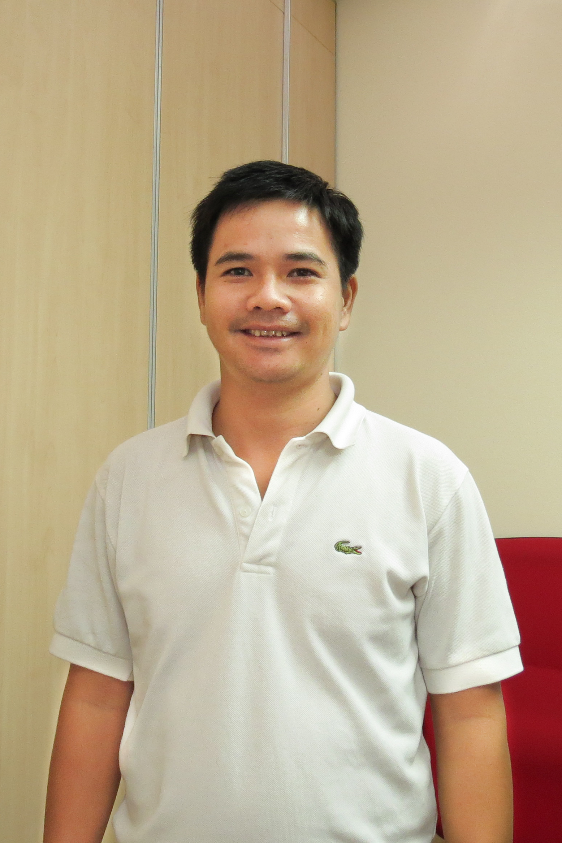

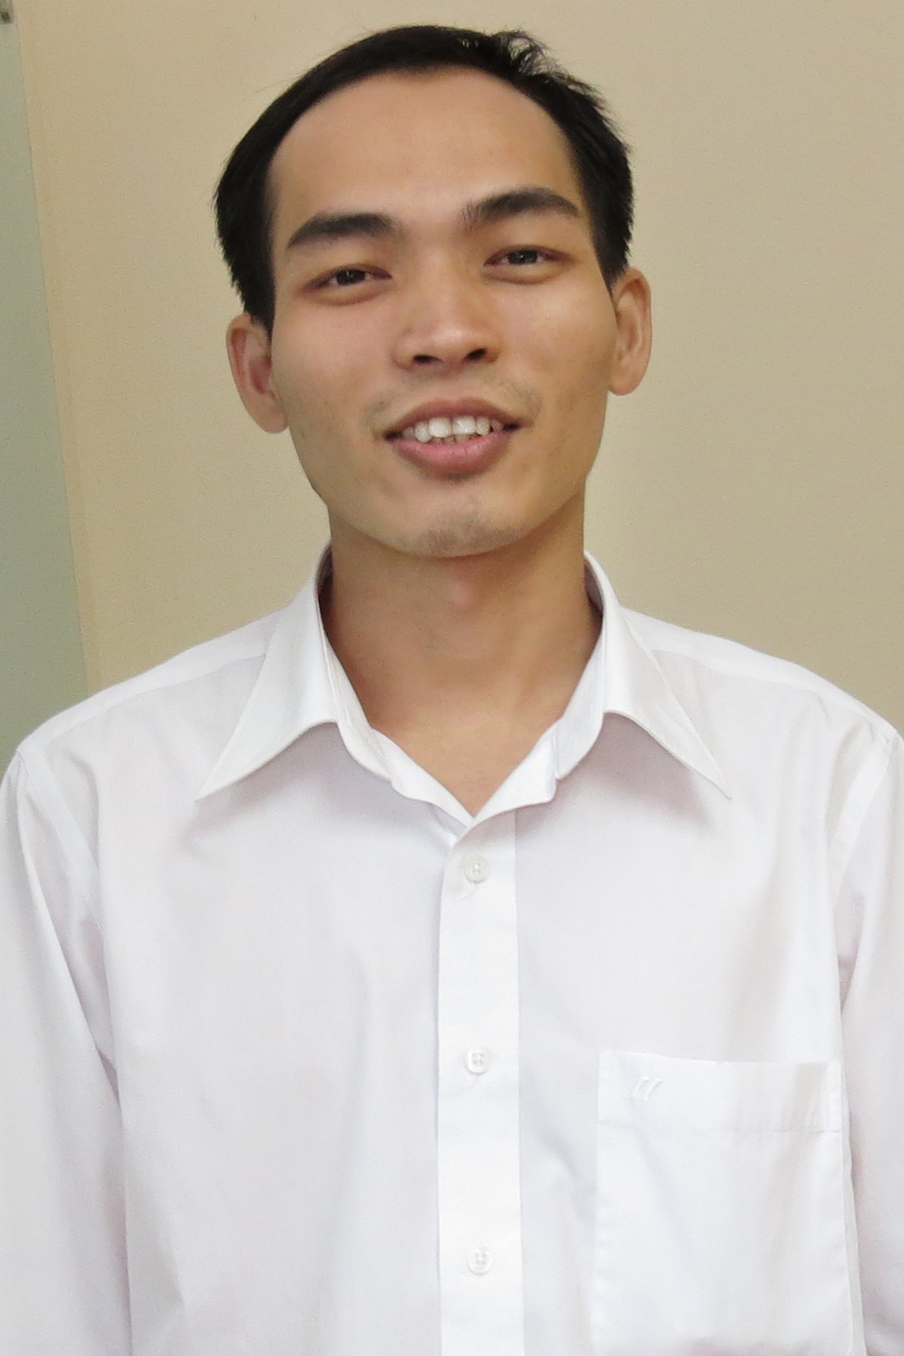
Team
12 teams
Conexus 1
Conexus 2
Crooze Mode
Conexus 3 (QC)
Sigurd
Conexus 4
WOTIF
IMAGEWARE
PM
KIKORA
MSP 1
Independent Work
MSP 2
3/29/2013
6

Slide 7
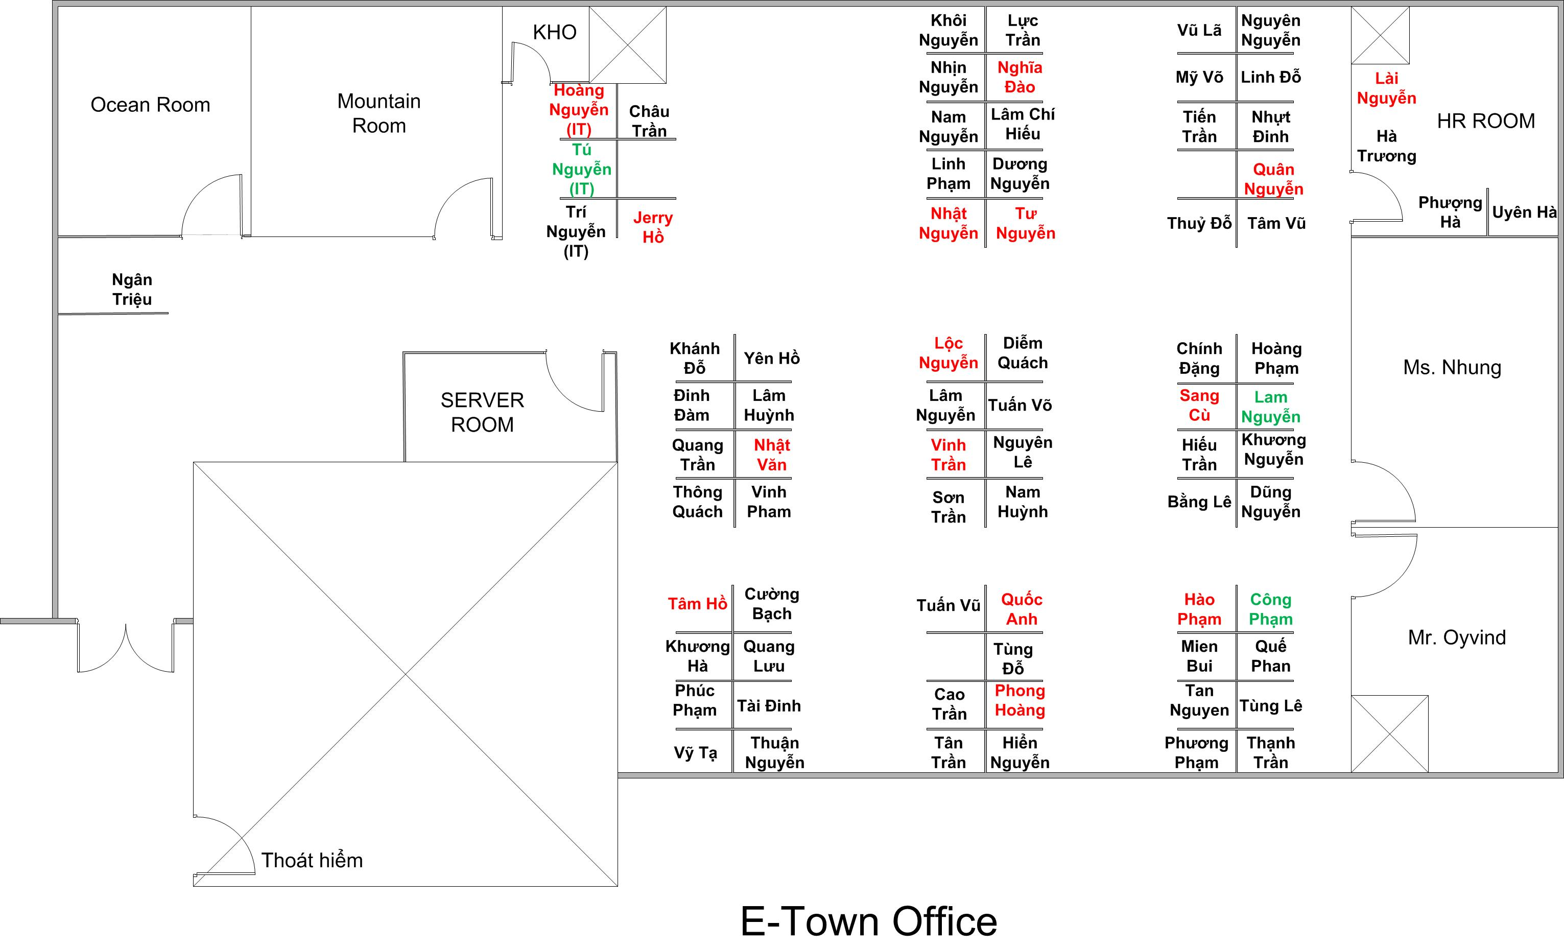
Seat Layout

Slide 8


General instruction
Booking meeting room (2 rooms): http://tools.orientsoftware.net/mrbs/
Management tool:
http://redmine.orientsoftware.net
HRM system: http://hr.orientsoftware.net
Public server:
\\Server2\public

Slide 9
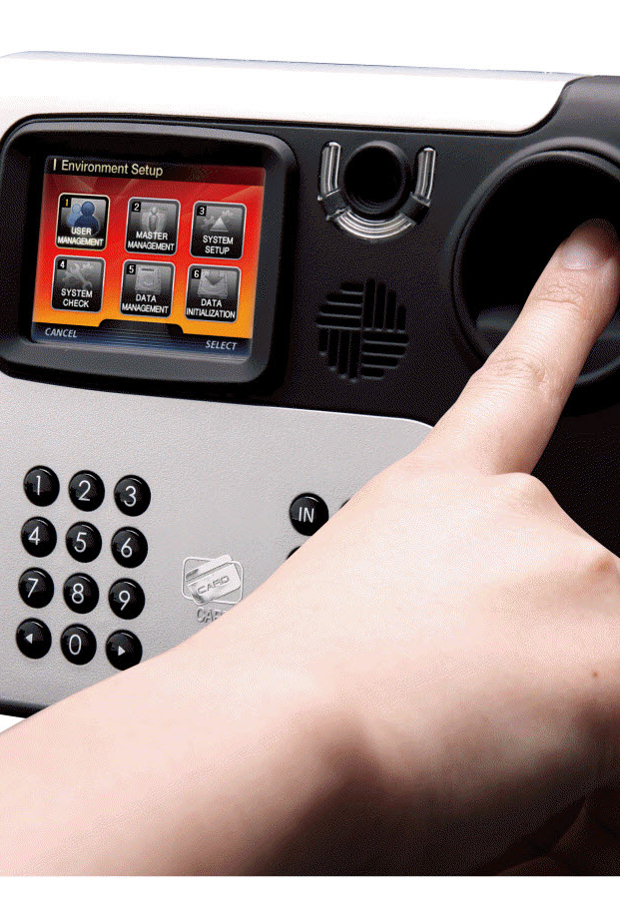

General policies
Check your finger in/out at access control
Working time: From Mon – Fri
Flexible: 8.00 (09.00) to 17.30 (19.30)
(Ensuring minimum 40 hours/week).
If the total working hour is less than 40 hours/week (excluding your leave), the salary will be subtracted in double (according to the missing amount)
Working time: If anyone starts working late than 9.00 am with more than twice (2 times) per week, your salary will be deducted 100,000 VND per week for your late working.
Lunch time break: 11.30 – 13.00

Slide 10
Annual leave
During probation time: you don’t have annual leave.
* Annual leave: must inform to your Team Leader/PO/…in advance.
+ Less than 3 days: 3 days in advance.
+ More than 3 days: 5 days in advance.
+ Do not encourage to being off without planning
* At the end of year, Annual leave can be paid by cash and be transferred to next year.

Slide 11
Probation time:
Working fully for one (01) month: will be paid in the end of month.
If not, company will pay your salary on 15th of the next month.
If employee want to stop his/her job (by your own decision) before one (1) month, the salary won’t be paid.

Slide 12



General policies
Free mineral water, coffee, tea and breakfast
Fridge is available for putting personal food & drink. Please don’t take what is not belong to you
No food left on the working places after finishing working (We will have mice in the office)
Keep our offices and restrooms clean
Allowance for Lunch: Supporting 400,000 VND/month/person basing on your working time.

Slide 13


General policies
Keep your cellphone on silent status
To avoid flu and other infections, care about hygiene(washing hands after being in restrooms, etc.)

Slide 14
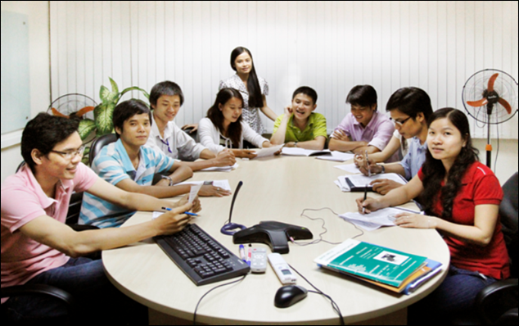
Employee benefits
English class every week: from 8.00 - 9.30 A.M
Monday & Wednesday: For all staff
Thursday: For team leader
TOEIC test: Every 2 months
Performance: Minimum 600 TOEIC scores

Slide 15
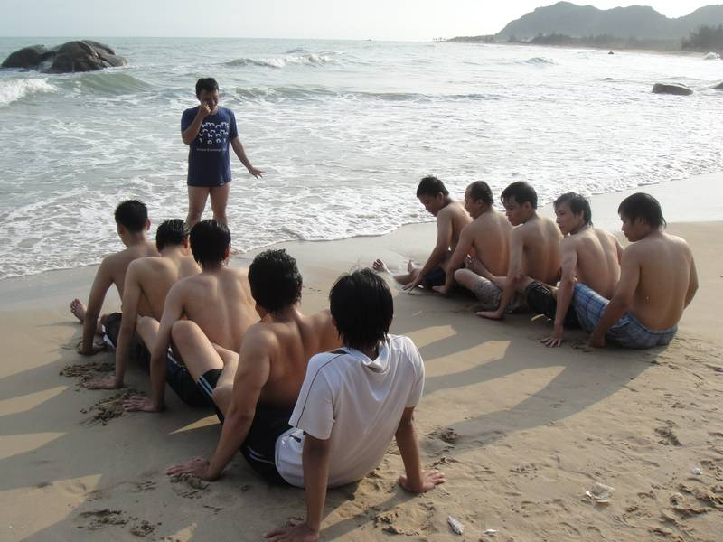
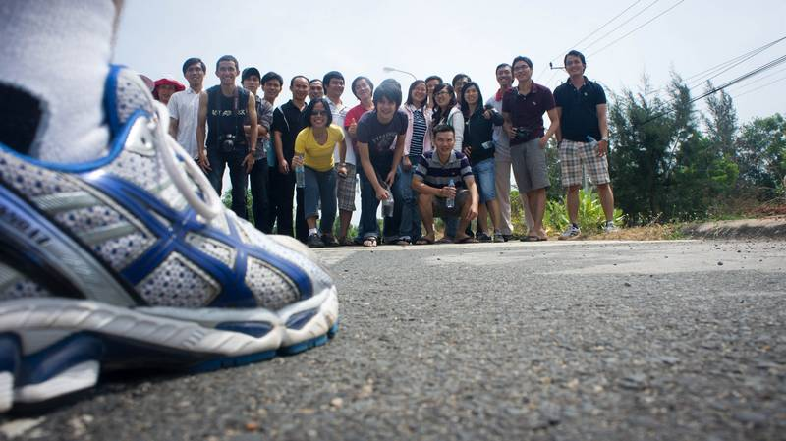
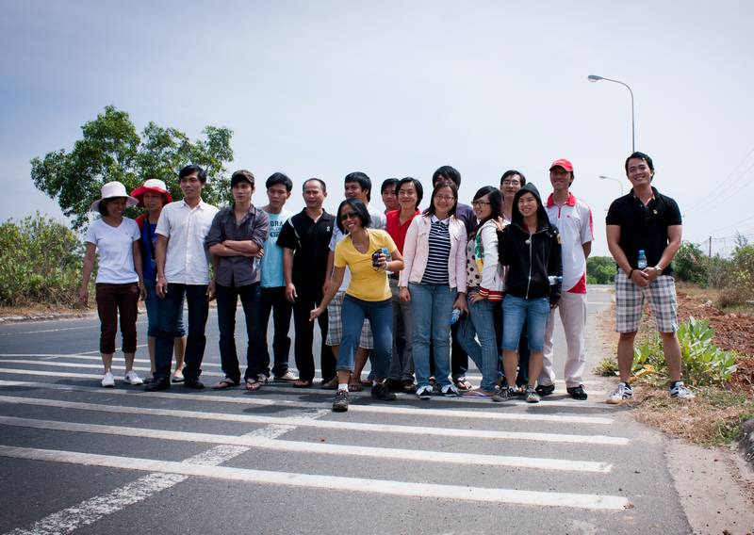
Outing activities
Company trip once a year to create good team spirit and great friendship, to build up the team work skills.

Slide 16
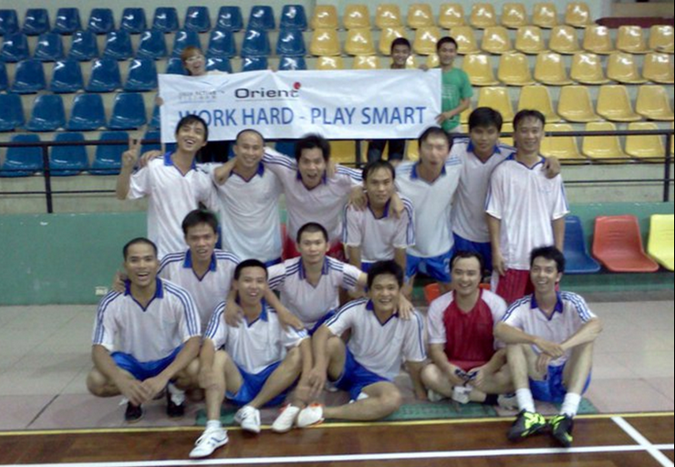
Sport Activities
Football match: Every Friday evening

Slide 17

Swimming Club
Weekly swimming for ladies

Slide 18



Extra- benefits
After 1 month working:
Parking fee: Provided
Accident Insurance 24/24: Provided
After 1 year working:
Health Insurance: Provided

Slide 19
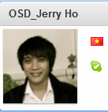

Organization
Use a clear photo for your Skype account, it helps our customers remind you.
Salary payment: Transfer via bank

Slide 20
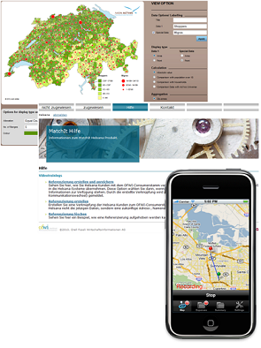
Our technology
We have extensive
knowledge in
technologies like:
Java
Microsoft.NET, C#,
VB.NET, ASP, ASP.NET,
PHP, C/C++
iPhone,
iPad apps

Slide 21
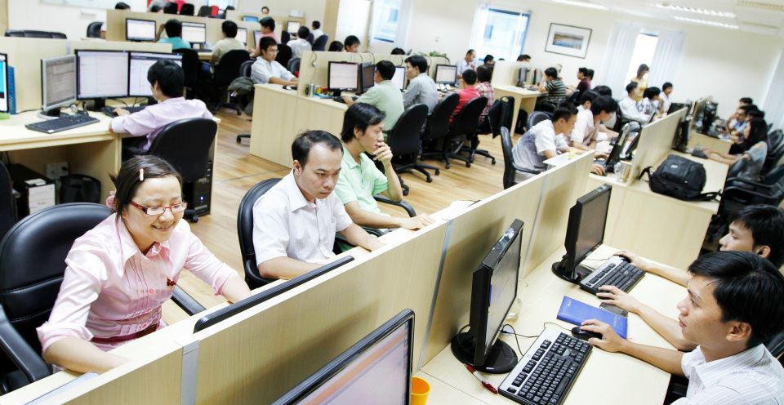
Environment
Professional international work environment with modern office infrastructure.

Slide 22
CONTACT INFORMATION
ORIENT SOFTWARE DEVELOPMENT CORP.
5th floor, Suite 5.8, Etown1 building, 364 Cong Hoa Str, Ward 13, Tan Binh Dist, Ho Chi Minh City
Land Line: +84 8 3812 0101, Fax : +84 8 3810 5273
Email: info@orientsoftware.net
Website: www.orientsoftware.net

